Slide 1
Internal Computing Components

Slide 2
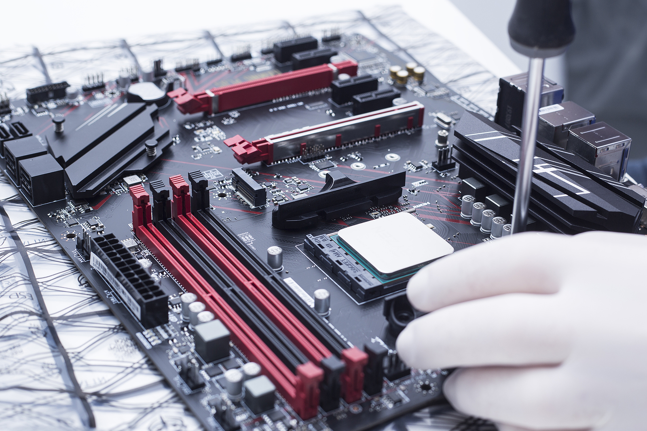
Internal Computing Components
Motherboard
All components are connected to this
Contains the main components of a system
Firmware
Set-up program on the motherboard
Allows system to talk with components
Modern firmware: UEFI
Older firmware: BIOS

Slide 3
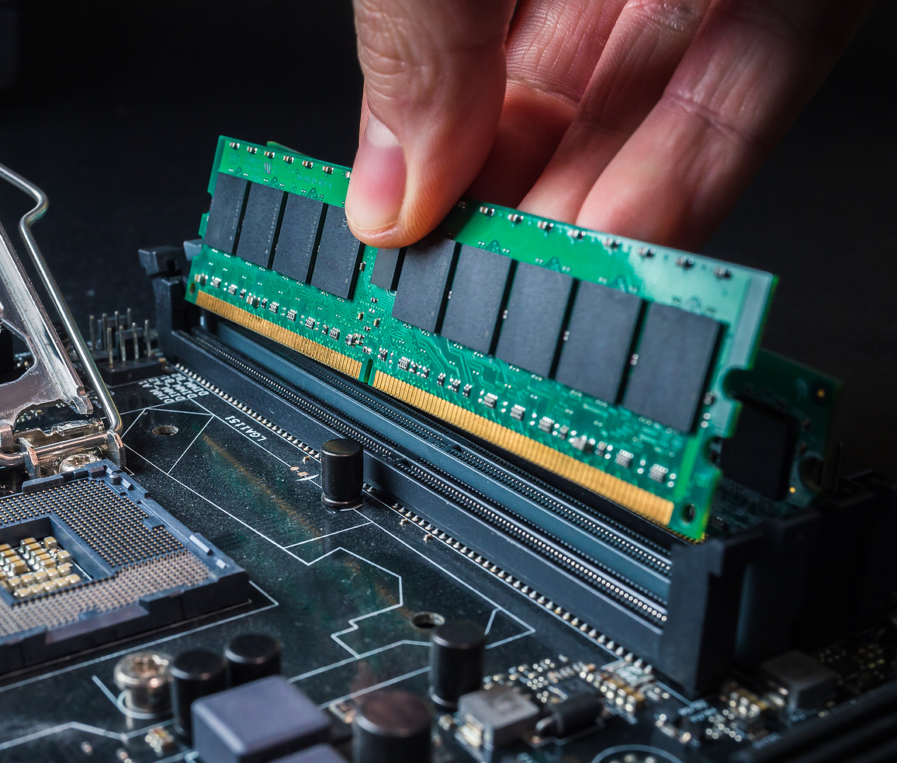
Internal Computing Components
RAM (Random Access Memory)
Data that can be accessed randomly
Very fast, but expensive
Data that needs accessed at that moment
Volatile memory (erased when shut down)

Slide 4
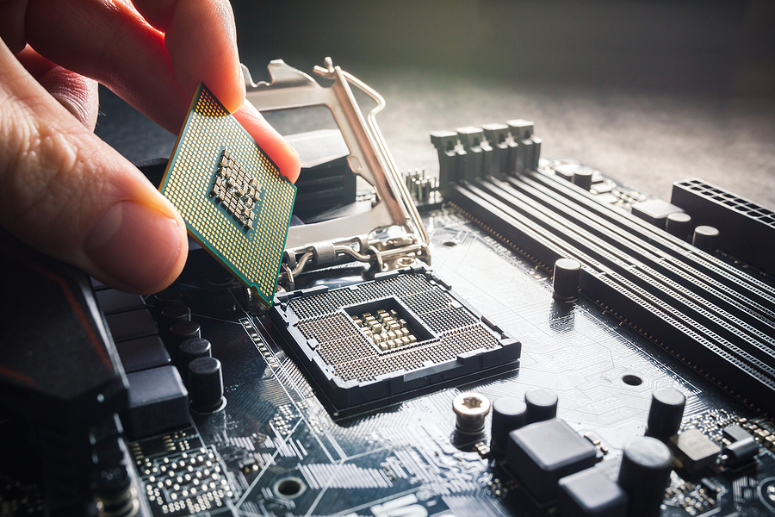
Internal Computing Components
CPU (Central Processing Unit)
The processor
Processes all the data
Two manufacturers
Intel
Celeron
Pentium
Core
AMD
Sempron
Athlon
Phenom

Slide 5
Internal Computing Components
CPU
ARM
Architecture used for CPU chips
Instructions for computing
Very fast and efficient
32-bit vs 64-bit
64-bit is more powerful
32-bit is being phased out
A 64-bit system can run a 32-bit OS
A 32-bit system can NOT run a 64-bit OS

Slide 6
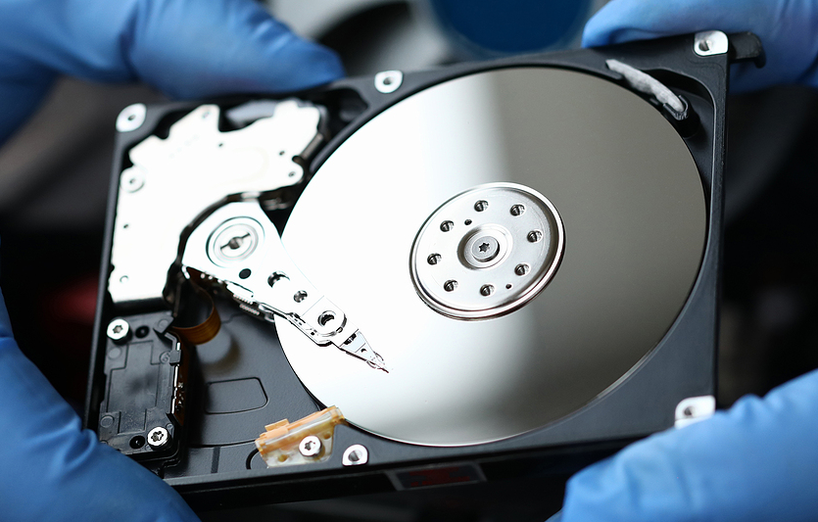
Internal Computing Components
Storage
Long term storage
HDD (Hard Disk Drive)
Stores data on magnetic disks
Moving parts
Cheaper but slower
SSD (Solid State Drive)
Stores data on chips
No moving parts
More expensive, but faster
Inside of a HDD

Slide 7
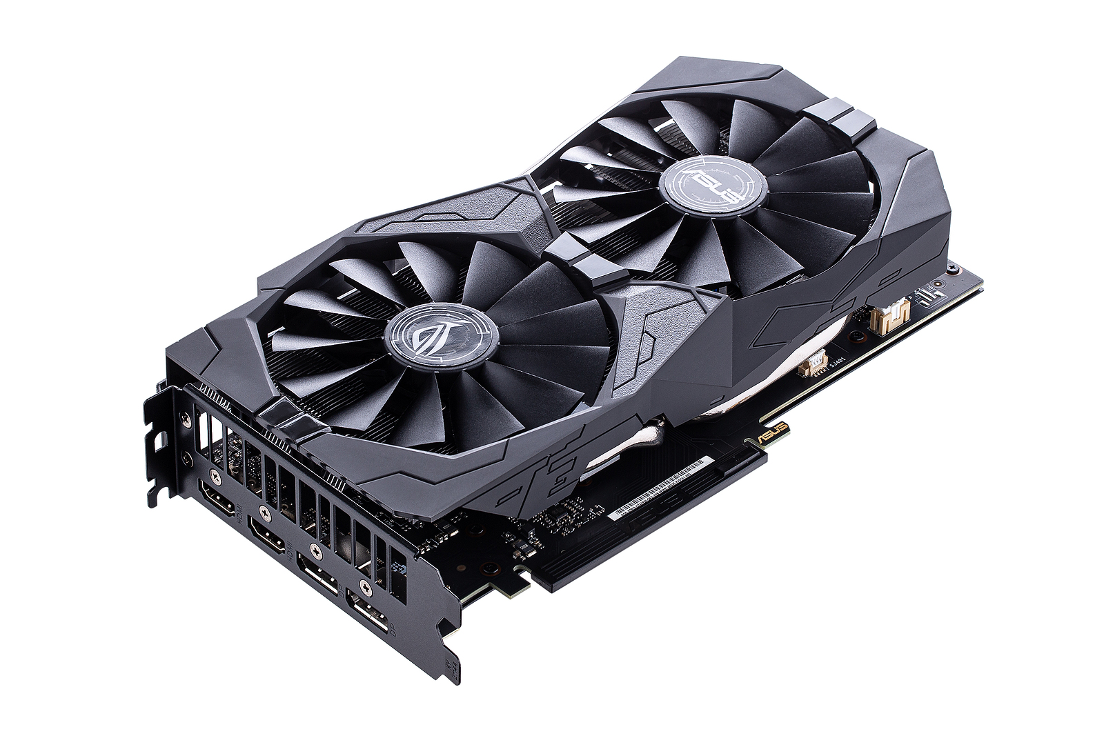
Internal Computing Components
GPU (Graphics Processing Unit)
Displays the images
Integrated GPU
Built into CPU
Works for simple tasks
Dedicated GPU
More powerful
Used for video editing, gaming, etc…
Major manufacturers are AMD and Nvidia

Slide 8
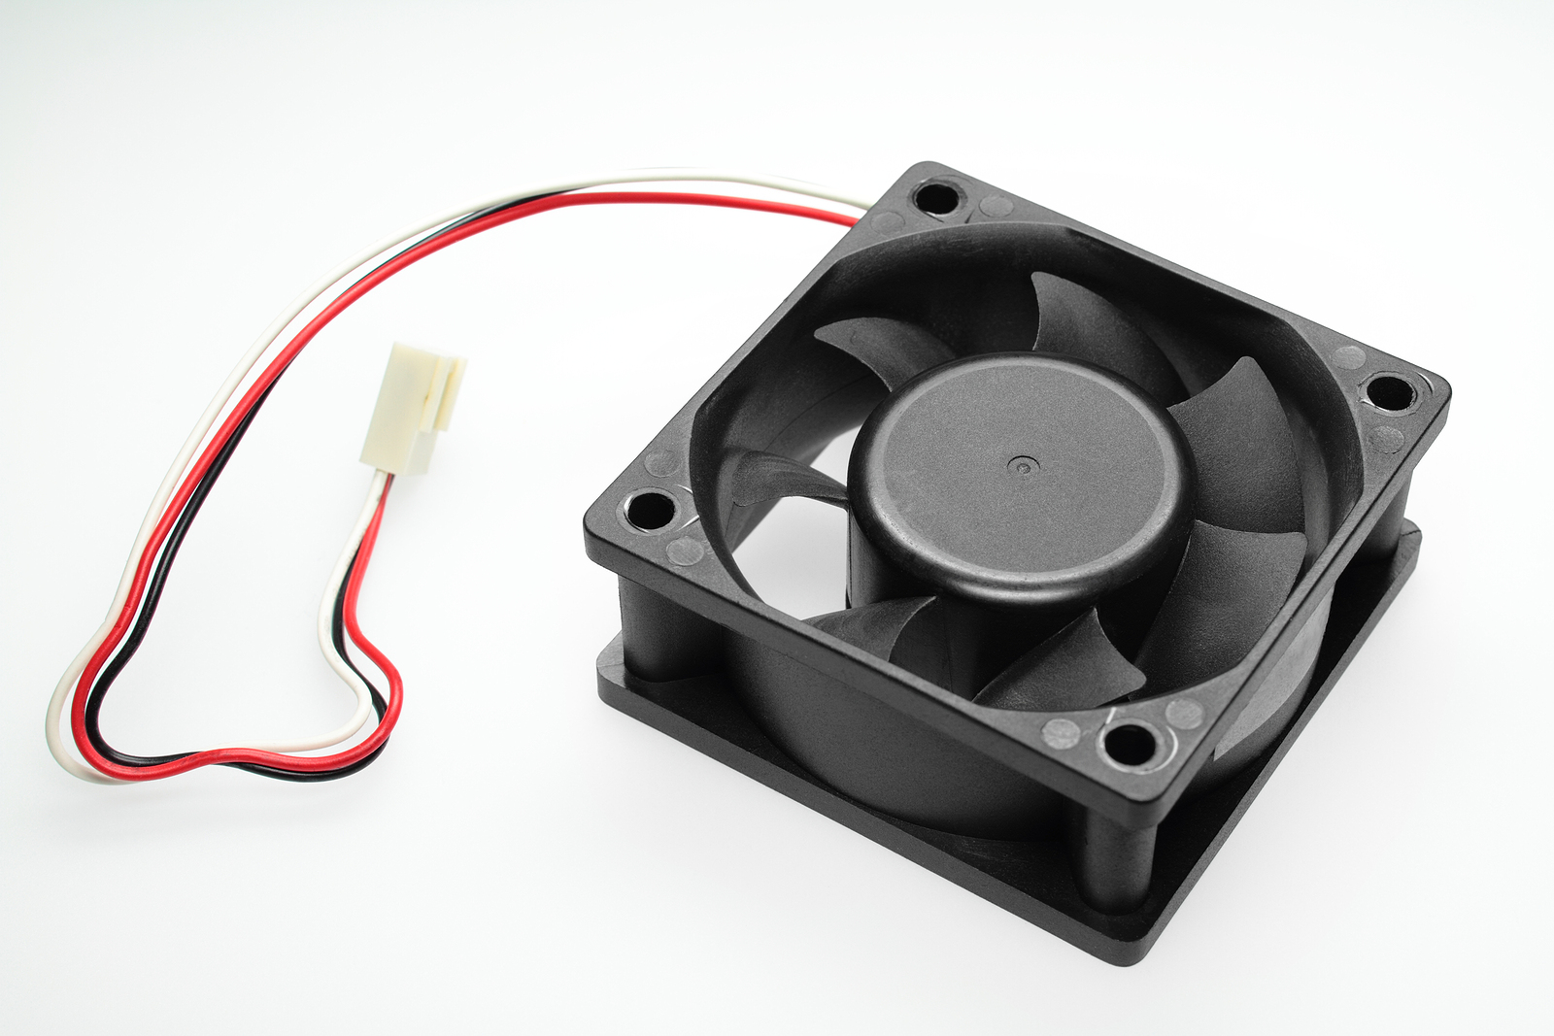
Internal Computing Components
Cooling
Keeps the system cool
Prevents overheating
Heatsink
Placed on top of chips
Fans
Keeps air circulating
Liquid
Moves cool liquid through a system

Slide 9
Internal Computing Components
NIC (Network Interface Card)
Connects the system to a network
Wired
Allows a wired connection
Wireless
Allows a wireless connection
A lot of times they are built on the motherboard

